Slide 1
Fatigue Risk Management

Slide 2
Fatigue vs. Sleepiness
Fatigue: response to sleep deprivation or prolonged physical or mental exertion
  Physical vs. cognitive (may be independent)
  Reduced by sedentary activity or rest without sleep
  Slowed reaction time>reduced vigilance>reduced decisionmaking capacity>impaired judgment>distraction>loss of awareness
Sleepiness: desire or propensity to fall asleep
  Exacerbated by sedentary activity or rest
  Decreased alertness>decreased attention to detail>impaired judgment>slowed response time

Slide 3
Sleep and Circadian Rhythms
Sleep stages (1-4, REM)
Range 6-10 hrs (ave. 7-8)
Intrinsic circadian cycle 24+ hours
Environmental cues reinforce
Regulates body temp, hormone secretion, sleep/wake
Sleep drive peaks at 2-4 a.m. and lesser peak at 1-3 p.m.
Individual variability in adaption to circadian disturbances

Slide 4
Fatigue & Sleepiness
Related to duration and timing of sleep
  Shift work can impair both
Correlated with increase in accidents and injury
Correlated with adverse physiologic and medical outcomes

Slide 5
Fatigue Risk Factors
Sleep insufficiency or deprivation
Circadian variability
Time awake
Health factors (sleep disorders, medication, etc.)
Environmental factors (light, noise, climate, etc.)
Workload and rest breaks

Slide 6
Shift Work
Work outside of usual daytime hours (7 a.m. – 6 p.m.)
Overtime work (> 40 hrs/week)
Extended work (> 8 hrs/day)
Irregular shifts (split or rotating shifts)
On call work
20% of U.S. workers are shift workers

Slide 7
2010 Sleep in America Poll
1/4 of respondents said work schedule prevented adequate sleep
1/3 of respondents said they did not have enough sleep for optimal function

Slide 8
Effects
24 hours of sleep deprivation comparable to 0.10% blood alcohol
Loss of two hours per night for one week can lead to similar performance decrements
Incidents related to time of day rather than time on task with peak risk at early morning hours (peak sleepiness)
Significant individual differences in level of alertness and performance

Slide 9
National Highway Traffic Safety Administration (NHTSA)
Fatigue causes or contributes to:
  100,000 police reported crashes annually
  1550 deaths
  71,000 injuries
  $12.5 B in economic losses

Slide 10
Healthcare Workers
Extended work shifts over 12 hours result in an increased risk of:
  Medical errors
  Sharps injuries
  Motor vehicle accidents going home

Slide 11
Manufacturing Workers
Risk of work injury increases with decreasing hours of sleep and increasing hours of work
88% excess risk in working >64 hours/week vs. working <40 hours/week
$1967 per employee per year in lost productivity
Productivity 3x loss when fatigue combined with condition specific productivity loss

Slide 12
Chronic Health Effects
Association of decreased sleep duration or disturbance with:
  Diabetes
  Hypertension
  Cardiovascular disease
  Obesity and Metabolic Syndrome
  Adverse Reproductive Outcomes
  Cancer
  IARC (2007) Shiftwork is Probable Human Carcinogen (Group 2A)

Slide 13
Worker Health Effects
Overtime (NIOSH)
Shift work (NZ Nurses)
Poor perceived general health
Weight gain and obesity
Increased alcohol and smoking
Increased injury, illness and mortality
Decreased neuropsychological test performance
Higher absence
More medical utilization
More self-reported symptoms
Disrupted social relationships

Slide 14
Societal Effects
Advent of electricity and artificial lighting
  1910: average sleep duration 9 hrs/night
  Today: average sleep duration 7 hrs/night
Industrialization
  24/7 operations
Communications and globalization
  Working across time zones

Slide 15
Hours of Service Regulations
Department of Transportation
  FMCSA: Truck drivers
  FAA: Air crews
  FRA: Rail crews
ACGME
  Medical residents

Slide 16
Nuclear Power Plant Incidents
Three Mile Island at 4 a.m. on March 28, 1979 shiftworkers failed to recognize the loss of core coolant water resulting from a stuck valve. Although a mechanical problem precipitated the incident, it was chiefly this human error of omission and the subsequent flawed corrective action that caused the near meltdown of the reactor later that morning.
Davis-Besse Reactor, Oak Harbor, Ohio, at 1:35 a.m. on June 9, 1985 went into automatic shutdown followed by a total loss of the main feedwater, operator then pushed the wrong two buttons in the control room, thereby defeating the safety function of the auxiliary feed-water system.
Rancho Seco nuclear reactor near Sacramento, California, at 4:14 a.m. on December 26, 1985, automatically tripped after DC power to the integrated control system was lost. For a variety of reasons, including equipment design flaws, inadequate training, and human errors of omission and commission, operators were slow to regain control.
Chernobyl is officially acknowledged to have begun at 1:23 a.m. on April 26, 1986 as the result of human error. The limited amount of information currently available about the human factors component of this accident.

Slide 17
NASA
Columbia near-disaster on January 6, 1986
  Operator fatigue was reported “as one of the major factors contributing to this incident”. The operators had been on duty for 11 h. It was their 3rd day of working on a 12-h night shift. As is often the case in industrial accidents, the contribution of human error was precipitated by an unusual mechanical or control system malfunction. In this case, such a malfunction occurred during the final tanking procedure. The Commission concluded, “An evaluation by NASA of the consequences of work schedules should be conducted as part of its effort to reform its launch and operational procedures”
Challenger explosion on January 28, 1986
  Presidential Commission on the Space Shuttle Challenger Accident did cite the contribution of human error and poor judgement related to sleep loss and shiftwork during the early morning hours substantial sleep loss experienced by senior managers at Marshall Space Flight Center before the evening teleconference with Morton-Thiokol on January 27, 1986, the report stated that the decision to launch “should have been based on engineering judgments. However, other factors may have impeded or prevented effective communication and exchange of information”

Slide 18
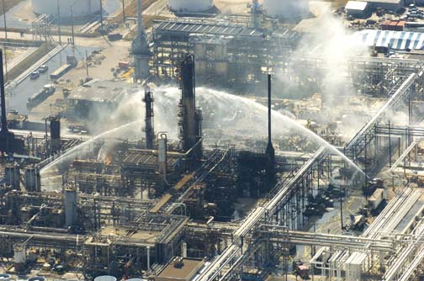
2005 BP Texas Refinery Explosion
Killed 15 and injured more than 180
BP and the U.S. Chemical Safety and Hazard Investigation Board reports identified numerous technical and organizational failings
Control room operators were working their 30th consecutive 12-hour night shift

Slide 19
ANSI/API Recommended Practice RP755
“Fatigue Risk Management Systems for Personal in the Refining and Petrochemical Industries”
Developed as an alternative to hours of service regulations
Specifically written for US facilities operating under OSHA’s Process Safety Management Standard
Can be adapted to upstream processes, other industries, and international operations

Slide 20
Fatigue Risk Management Systems (FRMS)
Comprehensive approach to:
  Measuring
  Mitigating
  Managing
  Actual fatigue risk in an organization
Outcomes-based
More flexible than duty-rest and hours of service regulations

Slide 21
FRMS Components
Fatigue Management Policy
Fatigue Risk Analysis and Mitigation
Fatigue Reporting System
Fatigue Incident Investigation
Fatigue Training & Education (Employees, Management and Families)
Sleep Disorder Management
Internal and External Auditing
Continuous Feedback & Improvement

Slide 22
FRMS
Australia & New Zealand and European agencies implemented FRMS rules for road and air transportation as alternative to hours of service rules.
Australian Medical Association also implemented for shift work and extended hours operations
Also applied to mining and pipeline operations in U>S> and Australia

Slide 23
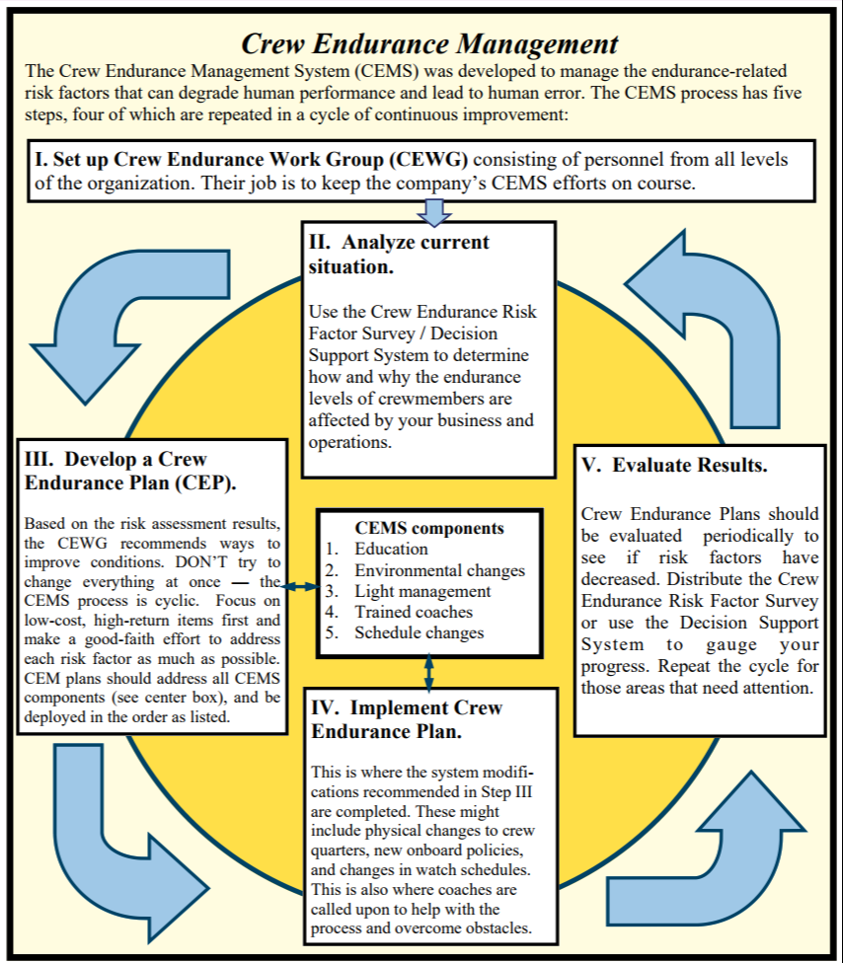
U.S. Coast Guard
Crew Endurance Management System (CEMS)
“reduce the risk of maritime and personal accidents by addressing and reducing the occurrence of endurance-related risk factors”

Slide 24
FRMS Interventions
Balancing Workload and Staffing
Shift Scheduling
Fatigue Training
Sleep Disorder Recognition and Treatment
Workplace Environment
Fatigue Monitoring and Fitness for Duty

Slide 25
Balancing Workload and Staffing
Staffing levels influence shift timing and duration
Effect of scheduled and unscheduled employee absences
Variability in workload
  External: Changes in supply and demand
  Internal: Planned and unplanned shutdowns or slowdowns

Slide 26
Consequences of Workload and Staffing Imbalance
Turnover
Overtime
Absenteeism

Slide 27
Shift Scheduling
Leads to sleep deprivation and circadian disturbance
Exaggerated drowsiness from combined effect in early morning hours (increased sleep drive).
Sleep duration and timing (break of more than 8 hours between shifts and nighttime sleep is more restorative)

Slide 28
Mitigation Strategies
Opportunities to obtain adequate sleep, particularly at night
Maximizing quality of sleep through training and environment
Maximizing alertness on the job by task scheduling, task engineering and environmental changes
Phase resetting strategies (shift rotation, light/dark)

Slide 29
Australian Obtained Sleep Model
START RULE: employee must have obtained 5 hours of sleep in the prior 24 hours and 12 hours of sleep in the 48 hours prior to commencing work
FINISH RULE: period from waking up to the end of shift should not exceed the amount of sleep obtained in the 48 hours prior to beginning the shift.

Slide 30
Shift Duration
Evidence that performance decreases and risk increases after 8 hours
Cognitive fatigue is independent of physical fatigue
Breaks reduce risk associated with shifts > 8 hrs
Breaks should include consideration of:
  Job demands
  Time on task
  Shift duration
  Physical needs

Slide 31
Fatigue Training
Training specific to workers and family
  Sleep and fatigue physiology
  Fatigue hazards
  Health and social impact
  Sleep hygiene and disorders
  Fatigue recognition
  Alertness strategies
Additional training for managers
  Staffing, scheduling and training considerations

Slide 32
Training Resources
NIOSH provides fatigue awareness and prevention training for:
  Nurses (online with CE credit)
  Truck and other motor vehicle drivers
  AK Bush Pilots
  Mines
US FAA for aviation
US Coast Guard for maritime operations
Industry associations

Slide 33
Sleep Disorder Recognition and Treatment
40 million Americans
85 different sleep disorders, most prevalent are:
  Sleep apnea
  Acute or chronic insomnia
  Restless leg syndrome
  Narcolepsy
  Circadian rhythm disorders (shift work sleep disorder)
$60B accidents, medical costs and lost productivity

Slide 34
Sleep Disorder Recognition and Treatment
Screening
  Questionnaires (Epworth, Berlin, Stanford)
Diagnosis
  Sleep study (polysomnography) (lab vs. home)
  Sleep Latency and Maintenance of Wakefulness
Treatment
  Specific to disorder (sleep hygiene, PAP, surgery, medications, etc.)
Compliance monitoring
  Early and ongoing
  Data driven

Slide 35
Workplace Environment
Should be designed to promote wakefulness and alertness
  Light, temperature, humidity, ventilation, noise
  Task design, human factors, human-machine interface, fatigue monitoring and countermeasures
Scheduling of critical tasks
Bright night shift lighting with filtering of < 480nm wavelengths
Breaks or opportunities for exercise, social interaction, napping, food, caffeine, etc.

Slide 36
Fatigue Monitoring and Fitness for Duty
Self, coworker and supervisor monitoring for signs of fatigue
Fatigue mitigation and intervention
Rest breaks
Referral for medical evaluation
Fatigue monitoring technology
  Operator monitoring
    Physiologic
    Performance
  Psychomotor testing

Slide 37
Feedback and Improvement
Monitoring key metrics
  Overtime, absence and turnover
  Incidents and injuries
  Medical costs and productivity
Incident investigation
  Was there potential for fatigue-related factors?
  Was there evidence of performance impairment (inaction or inattention)?

Slide 38
Incident Investigation
Operator factors
  Sleep-wake patterns 72 hours prior to incident
  Sleep interruptions
  Hours working 7 days prior to incident (overtime, extended shifts)
  Circadian factors
Scheduling factors
  Time of incident
  Work schedule (start/stop, duration)
Medical factors
  Sleep disorders
  Comorbid conditions
  Medications (Rx, OTC, illicit)

Slide 39
Conclusion
Fatigue is an unsafe working condition
Fatigue can be managed
Any organization can benefit
Particularly safety sensitive industries
  Transportation
  Healthcare
  Energy

Slide 40
Thank you!
Sleep well!

